Slide 1
Distributed Query Optimization
Chapter 8
Optimization of Distributed
Queries
Notes:
1

Slide 2
Outline
Overview of Query Optimization
Centralized Query Optimization
  Ingres
  System R
Distributed Query Optimization

Slide 3
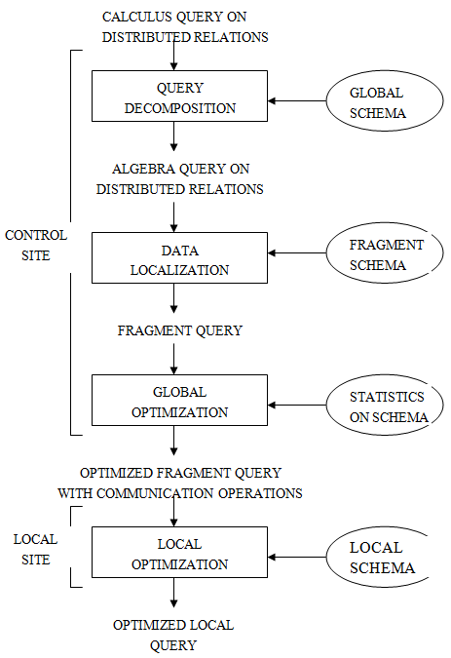

Slide 4
Step 3: Global Query Optimization
The query resulting from decomposition and localization can be executed in many ways by choosing different data transfer paths.
We need an optimizer to choose a strategy close to the optimal one.

Slide 5
Problem of Global Query Optimization
Input: Fragment query
Find the best (not necessarily optimal) global schedule
  Minimize a cost function
  Distributed join processing
    Bushy vs. linear trees
    Which relation to ship where?
    Ship-whole vs. ship-as-needed
  Decide on the use of semijoins
    Semijoin saves on communication at the expense of more local processing
  Join methods
    Nested loop vs. ordered joins (merge join or hash join)

Slide 6
Cost-based Optimization
Solution space
  The set of equivalent algebra expressions (query trees)
Cost function (in terms of time)
  I/O cost + CPU cost + communication cost
  These might have different weights in different distributed environments (LAN vs. WAN)
  Can also maximize throughput
Search algorithm
  How do we move inside the solution space?
  Exhaustive search, heuristic algorithms (iterative improvement, simulated annealing, genetic, …)

Slide 7
Query Optimization Process
input query
Search Space
Generation
Transformation
Rules
equivalent query execution plan
Cost Model
Search Strategy
best query execution plan

Slide 8
Search Space
Search space characterized by alternative execution plans
Focus on join trees
For N relations, there are O(N!) equivalent join trees that can be obtained by applying community and associativity rules.

Slide 9
Three Join Tree Examples
SELECT ENAME, RESP
FROM EMP, ASG, PROJ
WHERE EMP.ENO = ASG.ENO AND ASG.PNO=PROJ.PNO
(a)
(b)
_{PNO}
_{ENO}
_{ENO}
PROJ
_{PNO}
EMP
EMP
ASG
PROJ
ASG
(c)
_{ENO,PNO}
X
ASG
PROJ
EMP

Slide 10
Restricting the Size of Search Space
A large search space →
  optimization time much more than the actual execution time
Restricting by means of heuristics
  Perform unary operations (selection, projection) when accessing base relations
  Avoid Cartesian products that are not required by the query
    E.g., previous (c) query plan is removed from the search space
(c)
_{ENO,PNO}
X
ASG
PROJ
EMP

Slide 11
Restricting the Size of Search Space (cont.)
Restricting the shape of the join tree
  Consider only linear trees, ignore bushy ones
    Linear tree –at least one operand of each operator node is a base relation
    Bushy tree – more general and may have operators with no base relations as operands (i.e., both operands are intermediate relations)
Linear Join Tree
Bushy Join Tree
R4
R3
R1
R2
R3
R4
R1
R2

Slide 12
Search Strategy
How to move in the search space?
  Deterministic and randomized
Deterministic
  Starting from base relations, joining one more relation at each step until complete plans are obtained
  Dynamic programming builds all possible plans first, breadth-first, before it chooses the “best” plan
    the most popular search strategy
  Greedy algorithm builds only one plan, depth-first
R4
R3
R3
R1
R2
R1
R2
R1
R2

Slide 13
Search Strategy (cont.)
Randomized
  Trade optimization time for execution time
  Better when > 5-6 relations
  Do not guarantee the best solution is obtained, but avoid the high cost of optimization in terms of memory and time
  Search for optimalities around a particular starting point
  By iterative improvement and simulated annealing
R3
R2
R1
R2
R1
R3

Slide 14
Search Strategy (cont.)
  First, one or more start plans are built by a greedy strategy
  Then, the algorithm tries to improve the start plan by visiting its neighbors. A neighbor is obtained by applying a random transformation to a plan.
    e.g., exchanging two randomly chosen operand relations of the plan.

Slide 15
Cost Functions
Total time
  the sum of all time (also referred to as cost) components
Response Time
  the elapsed time from the initiation to the completion of the query

Slide 16
Total Cost
Summation of all cost factors
Total-cost = CPU cost + I/O cost + communication cost
CPU cost = unit instruction cost * no. of instructions
I/O cost = unit disk I/O cost * no. of I/O’s
communication cost = message initiation + transmission

Slide 17
Total Cost Factors
Wide area network
  Message initiation and transmission costs high
  Local processing cost is low (fast mainframes or minicomputers)
Local area network
  Communication and local processing costs are more or less equal.
  Ratio = 1:1.6

Slide 18
Response Time
Elapsed time between the initiation and the completion of a query
Response time = CPU time + I/O time + communication time
CPU time = unit instruction time * no. of sequential instructions
I/O time = unit I/O time * no. of. I/Os
communication time = unit message initiation time *
no. of sequential messages +
unit transmission time*no. of sequential bytes

Slide 19
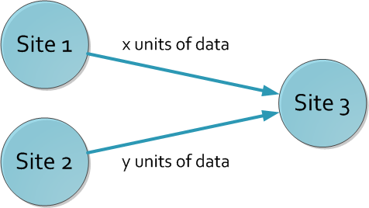
Example
Assume that only the
communication cost is
considered
Total time = 2 ∗ message initialization time + unit transmission time
∗ (x+y)
Response time = max {time to send x from 1 to 3, time to send y
from 2 to 3}
time to send x from 1 to 3 = message initialization time +
unit transmission time ∗ x
time to send y from 2 to 3 = message initialization time +
unit transmission time ∗ y

Slide 20
Optimization Statistics
Primary cost factor: size of intermediate relations
The size of the intermediate relations produced during the execution facilitates the selection of the execution strategy
This is useful in selecting an execution strategy that reduces data transfer
The sizes of intermediate relations need to be estimated based on cardinalities of relations and lengths of attributes
  More precise → more costly to maintain

Slide 21
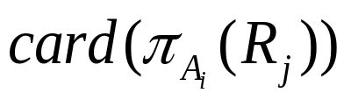
Optimization Statistics (cont.)
R [A₁, A₂,..., A_{n}] fragmented as R₁,R₂,…, R_{n}
The statistical data collected typically are
  len(A_{i}), length of attribute A_{i} in bytes
  min(A_{i}) and max(A_{i}) value for ordered domains
  card(dom(A_{i})), unique values in dom(A_{i})
  Number of tuples in each fragment card(R_{j})
  , the number of distinct values of A_{i} in fragment R_{j}
  size(R) = card(R)*length(R)

Slide 22
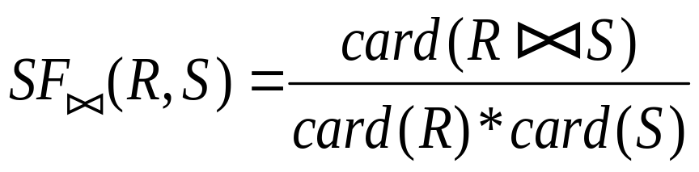
Optimization Statistics (cont.)
Selectivity factor of each operation for relations
  The join selectivity factor for R and S
    a real value between 0 and 1

Slide 23
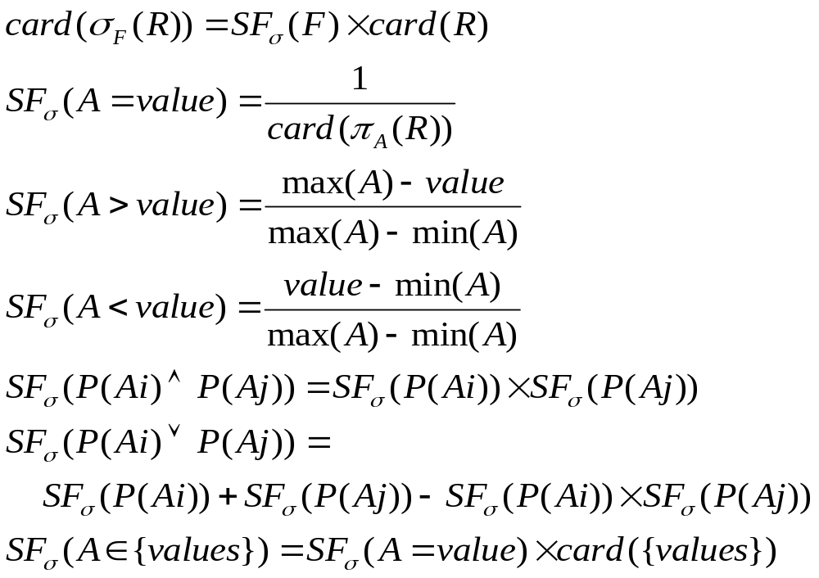
Intermediate Relation Size
Selection

Slide 24

Intermediate Relation Size (cont.)
Projection
the number of distinct values of A if A is a single attribute, or card(R) if A contains the key of R.
Otherwise, it’s difficult.

Slide 25
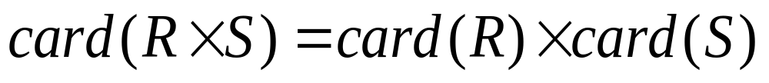
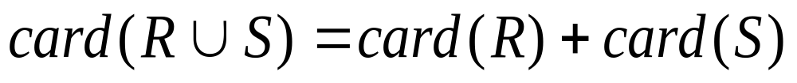
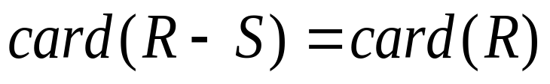
Intermediate Relation Size (cont.)
Cartesian product
Union
Upper bound:
Lower bound:
Set Difference
Upper bound:
Lower bound: 0

Slide 26
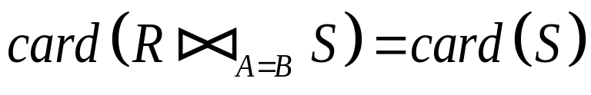
Intermediate Relation Size (cont.)
Join
  No general way for its calculation. Some systems use the upper bound of card(R*S) instead. Some estimations can be used for simple cases.
  Special case: A is a key of R and B is a foreign key of S
  More general:

Slide 27
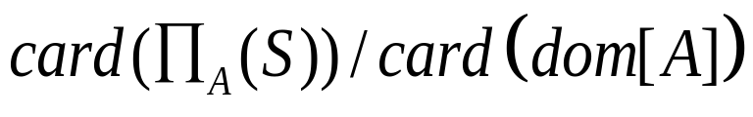
Intermediate Relation Sizes (cont.)
Semijoin
where
card (R _{A} S) = SF (S.A) * card(R)
SF (R _{A} S) = SF (S.A) =

Slide 28
Centralized Query Optimization
Two examples showing the techniques
INGRES – dynamic optimization, interpretive
System R – static optimization based on
exhaustive search

Slide 29
INGRES Language: QUEL
QUEL Language - a tuple calculus language
Example:
range of e is EMP
range of g is ASG
range of j is PROJ
retrieve e.ENAME
where e.ENO=g.ENO and j.PNO=g.PNO
and j.PNAME=”CAD/CAM”
Note: e, g, and j are called variables

Slide 30
INGRES Language: QUEL (cont.)
One-variable query
Queries containing a single variable.
Multivariable query
Queries containing more than one variable.
QUEL can be equally translated into SQL. So we just use SQL for convenience.

Slide 31
INGRES – General Strategy
Decompose a multivariable query into a sequence of mono-variable queries with a common variable
Process each by an one variable query processor
  Choose an initial execution plan (heuristics)
  Order the rest by considering intermediate relation sizes
No statistical information is maintained.

Slide 32
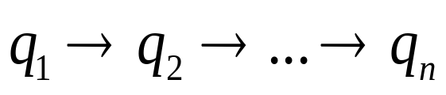
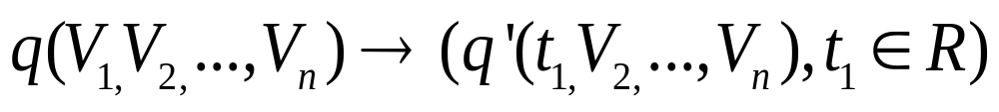
INGRES - Decomposition
Replace an n variable query q by a series of queries , where q_{i} uses the result of q_{i-1}.
Detachment
  Query q decomposed into q’→q’’, where q’ and q’’ have a common variable which is the result of q’
Tuple substitution
  Replace the value of each tuple with actual values and simplify the query

Slide 33

INGRES – Detachment
q:
SELECT V₂.A₂, V₃.A₃, …, V_{n}.A_{n}
FROM R₁ V₁, R₂ V₂, …, R_{n} V_{n}
WHERE P₁(V₁.A₁’) AND
P₂(V₁.A₁, V₂.A₂, …, V_{n}.A_{n})
Note: P₁(V₁.A₁’) is an one-variable predicate, indicating a chance for optimization, i.e. to execute first expressed in following query.

Slide 34
INGRES – Detachment (cont.)
q: SELECT V₂.A₂, V₃.A₃, …, V_{n}.A_{n}
FROM R₁ V₁, R₂ V₂, …, R_{n} V_{n}
WHERE P₁(V₁.A₁’) AND P₂(V₁.A₁, V₂.A₂, …, V_{n}.A_{n})
q’ - one variable query generated by the single variable predicate P₁:
SELECT V₁.A₁ INTO R₁’
FROM R₁ V₁
WHERE P₁(V₁.A₁’)
q’’ - in q, use R₁’ to replace R₁ and eliminate P₁:
SELECT V₂.A₂, V₃.A₃, …, V_{n}.A_{n}
FROM R₁’ V₁, R₂ V₂, …, R_{n} V_{n}
WHERE P₂(V₁.A₁, …, V_{n}.A_{n})

Slide 35
INGRES – Detachment (cont.)
Note
Query q is decomposed into q’ → q’’
It is an optimized sequence of query execution

Slide 36
INGRES – Detachment Example
Original query q₁
SELECT E.ENAME
FROM EMP E, ASG G, PROJ J
WHERE E.ENO=G.ENO AND
J.PNO=G.PNO AND
J.PNAME=“CAD/CAM”
q₁ can be decomposed into q₁₁→q₁₂→q₁₃

Slide 37
INGRES – Detachment Example (cont.)
First use the one variable predicate to get
q₁₁ and q’ such that q = q₁₁→ q’
q_{11:}
    SELECT J.PNO INTO JVAR
    FROM PROJ J
    WHERE PNAME=“CAD/CAM”
q’:
    SELECT E.ENAME
    FROM EMP E, ASG G, JVAR
    WHERE E.ENO=G.ENO
    AND G.PNO=JVAR.PNO

Slide 38
INGRES – Detachment Example (cont.)
Then q’ is further decomposed into q₁₂→q₁₃
SELECT G.ENO INTO GVAR
FROM ASG G, JVAR
WHERE G.PNO=JVAR.PNO
SELECT E.ENAME
FROM EMP E, GVAR
WHERE E.ENO=GVAR.ENO
q₁₂
q₁₃
q11 is a mono-variable query
q12 and q13 are subject to tuple substitution

Slide 39
Tuple Substitution
Assume GVAR has two tuples only: <E1> and <E2>, then q₁₃ becomes:
q₁₃₁
SELECT EMP.ENAME
FROM EMP
WHERE EMP.ENO = “E1”
SELECT EMP.ENAME
FROM EMP
WHERE EMP.ENO = “E2”
q₁₃₂

Slide 40
System R
Static query optimization based on exhaustive search of the solution space
Simple (i.e., mono-relation) queries are executed according to the best access path
Execute joins
  Determine the possible ordering of joins
  Determine the cost of each ordering
  Choose the join ordering with minimal cost

Slide 41
System R Algorithm
For joins, two join methods are considered:
  Nested loops
    for each tuple of external relation (cardinality n₁)
    for each tuple of internal relation (cardinality n₂)
    join two tuples if the join predicate is true
    end
    end
    Complexity: n₁*n₂
  Merge join
    Sort relations
    Merge relations
    Complexity: n₁+n₂ if relations are previously sorted and equijoin

Slide 42
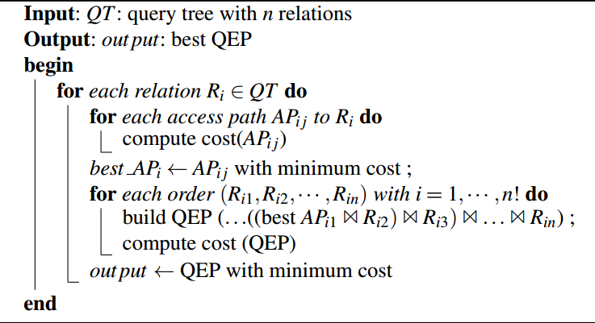
System R Algorithm

Slide 43
System R Algorithm - Example
Find names of employees working on the CAD/CAM project.
Assume
  EMP has an index on ENO
  ASG has an index on PNO
  PROJ has an index on PNO and an index on PNAME
ASG
ENO
PNO
EMP
PROJ

Slide 44
System R Example (cont.)
Choose the best access paths to each relation
  EMP: sequential scan (no selection on EMP)
  ASG: sequential scan (no selection on ASG)
  PROJ: index on PNAME (there is a selection on PROJ based on PNAME)
Determine the best join ordering
  EMP ASG PROJ
  ASG PROJ EMP
  PROJ ASG EMP
  ASG EMP PROJ
  EMP × PROJ ASG
  PROJ × EMP ASG
  Select the best ordering based on the join costs evaluated according to the two join methods

Slide 45
System R Example (cont.)
alternative joins
EMP
ASG
PROJ
EMP ASG
EMP × PROJ
ASG EMP
ASG PROJ
PROJ ASG
PROJ × EMP
(ASG EMP) PROJ
(PROJ ASG) EMP
Best total join order is one of
(ASG EMP) PROJ
(PROJ ASG) EMP

Slide 46
System R Example (cont.)
(PROJ ASG) EMP has a useful index on the select attribute and direct access to the join attributes of ASG and EMP.
Final plan:
  select PROJ using index on PNAME
  then join with ASG using index on PNO
  then join with EMP using index on ENO

Slide 47
Join Ordering in Fragment Queries
Join ordering is important in centralized DB, and is
more important in distributed DB.
Assumptions necessary to state the main issues
  Fragments and relations are indistinguishable;
  Local processing cost is omitted;
  Relations are transferred in one-set-at-a-time mode;
  Cost to transfer data to produce the final result at the result site is omitted

Slide 48
Join Ordering in Fragment Queries (cont.)
Join ordering
  Distributed INGRES
  System R*
Semijoin ordering
  SDD-1

Slide 49
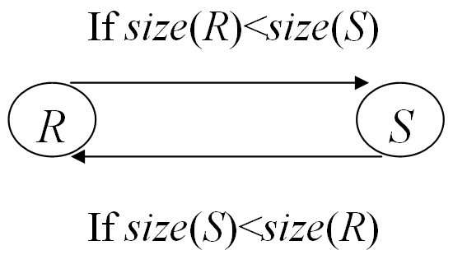
Join Ordering
Consider two relations only
  R ⋈ S
  Transfer the smaller size
Multiple relations more difficult because too many alternatives
  Compute the cost of all alternatives and select the best one
    Necessary to compute the size of intermediate relations which is difficult.
    Use heuristics

Slide 50
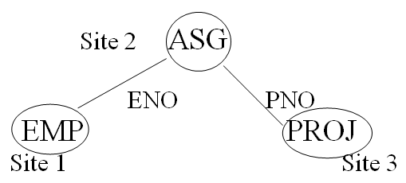
Join Ordering - Example
Consider: PROJ ⋈_{PNO} ASG ⋈_{ENO} EMP

Slide 51
Join Ordering – Example (cont.)
PROJ ⋈_{PNO} ASG ⋈_{ENO} EMP
Execution alternatives:
  1. EMP → Site 2
  Site 2 computes EMP’=EMP⋈ASG
  EMP’ → Site 3
  Site 3 computes EMP’⋈PROJ
  2. ASG → Site 1
  Site 1 computes EMP’=EMP⋈ASG
  EMP’ → Site 3
  Site 3 computes EMP’⋈PROJ

Slide 52
Join Ordering – Example (cont.)
PROJ ⋈_{PNO} ASG ⋈_{ENO} EMP
  3. ASG → Site 3
  Site 3 computes ASG’=ASG⋈PROJ
  ASG’ → Site 1
  Site 1 computes ASG’⋈EMP
  4. PROJ → Site 2
  Site 2 computes PROJ’=PROJ⋈ASG
  PROJ’ → Site 1
  Site 1 computes PROJ’ ⋈ EMP

Slide 53
Join Ordering – Example (cont.)
  5. EMP → Site 2
  PROJ → Site 2
  Site 2 computes EMP⋈ PROJ⋈ASG
PROJ ⋈_{PNO} ASG ⋈_{ENO} EMP

Slide 54
Semijoin Algorithms
Shortcoming of the joining method
  Transfer the entire relation which may contain some useless tuples
  Semi-join reduces the size of operand relation to be transferred.
Semi-join is beneficial if the cost to produce and send to the other site is less than sending the whole relation.

Slide 55
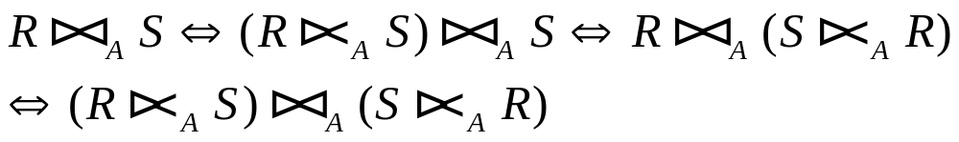
Semijoin Algorithms (cont.)
Consider the join of two relations
  R[A] (located at site 1)
  S[A] (located at site 2)
Alternatives
  1. Do the join R ⋈_{A} S
  2. Perform one of the semijoin equivalents

Slide 56



Semijoin Algorithms (cont.)
Perform the join
  Send R to site 2
  Site 2 computes R ⋈_{A} S
Consider semijoin
  S’ = Π_{A}(S)
  S’ → Site 1
  Site 1 computes
  R’ → Site 2
  Site 2 computes
Semijoin is better if

Slide 57
Distributed INGRES Algorithm
Same as the centralized version except
  Movement of relations (and fragments) need to be considered
  Optimization with respect to communication cost or response time possible

Slide 58
R* Algorithm
Cost function includes local processing as well as transmission
Consider only joins
Exhaustive search
Compilation
Published papers provide solutions to handle horizontal and vertical fragmentations but the implemented prototype does not

Slide 59
R* Algorithm (cont.)
Performing joins
Ship whole
  larger data transfer
  smaller number of messages
  better if relations are small
Fetch as needed
  number of messages = O(cardinality of external relation)
  data transfer per message is minimal
  better if relations are large and the selectivity is good

Slide 60
R* Algorithm (Strategy 1) -
Vertical Partitioning & Joins
Move the entire outer relation to the site of the inner relation.
The outer tuples can be joined with inner ones as they arrive
  (a) Retrieve outer tuples
  (b) Send them to the inner relation site
  (c) Join them as they arrive
  Total Cost = cost(retrieving qualified outer tuples)
  + no. of outer tuples fetched ∗
  cost(retrieving qualified inner tuples)
  + msg. cost ∗ (no. of outer tuples fetched ∗avg.
  outer tuple size) / msg. size

Slide 61
R* Algorithm (Strategy 2) -
Vertical Partitioning & Joins (cont.)
Move inner relation to the site of outer relation.
The inner tuples cannot be joined as they arrive, and they need to be stored in a temporary relation.
  Total Cost = cost(retrieving qualified outer tuples)
  + cost(retrieving qualified inner tuples)
  + cost(storing all qualified inner tuples in
  temporary storage)
  + no. of outer tuples fetched ∗ cost(retrieving
  matching inner tuples from temporary storage)
  + msg. cost ∗ (no. of inner tuples fetched ∗
  avg. inner tuple size) / msg. size

Slide 62
R* Algorithm (Strategy 3) -
Vertical Partitioning & Joins (cont.)
Fetch inner tuples as needed for each tuple of the outer relation. For each tuple in R, the join attribute value is sent to the site of S. Then the s tuples of S which match that value are retrieved and sent to the site of R to be joined as they arrive.
  (a) Retrieve qualified tuples at outer relation site
  (b) Send request containing join column value(s) for outer
  tuples to inner relation site
  (c) Retrieve matching inner tuples at inner relation site
  (d) Send the matching inner tuples to outer relation site
  (e) Join as they arrive

Slide 63
R* Algorithm (Strategy 3) -
Vertical Partitioning & Joins (cont.)
  Total Cost = cost(retrieving qualified outer tuples)
  + msg. cost ∗ (no. of outer tuples fetched ∗
  avg. outer tuple size) / msg. size
  + no. of outer tuples fetched ∗ cost(retrieving matching
  inner tuples for one outer value)
  + msg. cost ∗ (no. of inner tuples fetched ∗
  avg. inner tuple size) / msg. size

Slide 64
R* Algorithm (Strategy 4) -
Vertical Partitioning & Joins (cont.)
Move both inner and outer relations to another site.
The inner tuples are stored in a temporary relation.
  Total cost = cost(retrieving qualified outer tuples)
  + cost(retrieving qualified inner tuples)
  + cost(storing inner tuples in storage)
  + msg. cost ∗ (no. of outer tuples fetched ∗
  avg. outer tuple size) / msg. size
  + msg. cost ∗ (no. of inner tuples fetched ∗
  avg. inner tuple size) / msg. size
  + no. of outer tuples fetched ∗
  cost(retrieving inner tuples from temporary
  storage)

Slide 65
Hill Climbing Algorithm
Assume join is between three relations.
Step 1: Do initial processing
Step 2: Select initial feasible solution (ES₀)
  2.1 Determine the candidate result sites – sites where a
  relation referenced in the query exists
  2.2 Compute the cost of transferring all the other referenced
  relations to each candidate site
  2.3 ES₀ = candidate site with minimum cost

Slide 66
Hill Climbing Algorithm (cont.)
Step 3: Determine candidate splits of ES₀ into {ES₁,
ES₂}
  3.1 ES₁ consists of sending one of the relations to the other
  relation's site
  3.2 ES₂ consists of sending the join of the relations to the
  final result site
Step 4: Replace ES₀ with the split schedule which
gives
  cost(ES₁) + cost(local join) + cost(ES₂) < cost(ES₀)

Slide 67
Hill Climbing Algorithm (cont.)
Step 5: Recursively apply steps 3–4 on ES₁ and
ES₂ until no such plans can be found
Step 6: Check for redundant transmissions in the
final plan and eliminate them.

Slide 68
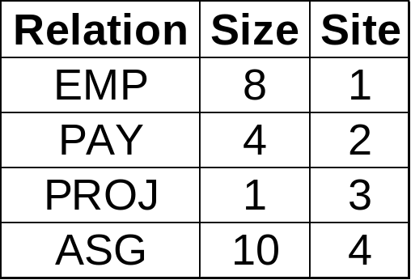
Hill Climbing Algorithm - Example
What are the salaries of engineers who work on the
CAD/CAM project?
Π_{SAL}(PAY ⋈ _{TITLE}(EMP ⋈_{ENO} (ASG ⋈_{PNO}(σ _{PNAME=“CAD/CAM”} (PROJ)))))
Assume:
  Size of relations is defined as their cardinality
  Minimize total cost
  Transmission cost between two sites is 1
  Ignore local processing cost

Slide 69
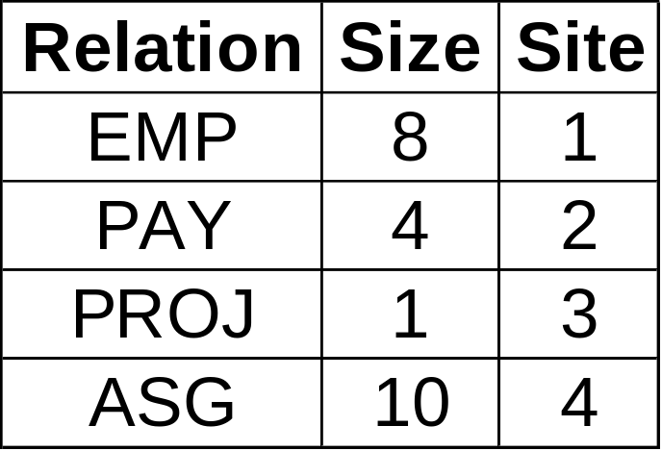
Hill Climbing – Example (cont.)
Step 1: Do initial processing
Selection on PROJ; result has cardinality 1

Slide 70
Hill Climbing – Example (cont.)
Step 2: Initial feasible solution
Alternative 1: Resulting site is Site 1
  Total cost = cost(PAY→Site 1) + cost(ASG→Site 1) + cost(PROJ→Site 1) = 4 + 10 + 1 = 15
Alternative 2: Resulting site is Site 2
  Total cost = 8 + 10 + 1 = 19
Alternative 3: Resulting site is Site 3
  Total cost = 8 + 4 + 10 = 22
Alternative 4: Resulting site is Site 4
  Total cost = 8 + 4 + 1 = 13
Therefore ES₀ = {EMP → Site 4; PAY → Site 4; PROJ → Site 4}

Slide 71
Hill Climbing – Example (cont.)
Step 3: Determine candidate splits
Alternative 1: {ES₁, ES₂, ES₃} where
  ES₁: EMP → Site 2
  ES₂: (EMP ⋈ PAY) → Site 4
  ES₃: PROJ → Site 4
Alternative 2: {ES₁, ES₂, ES₃} where
  ES₁: PAY → Site 1
  ES₂: (PAY ⋈ EMP) → Site 4
  ES₃: PROJ → Site 4

Slide 72
Hill Climbing – Example (cont.)
Step 4: Determine costs of each split alternative
  cost(Alternative 1) = cost(EMP→Site 2) +
  cost((EMP ⋈ PAY)→Site 4) + cost(PROJ → Site 4)
  = 8 + 8 + 1 = 17
  cost(Alternative 2) = cost(PAY→Site 1) +
  cost((PAY ⋈ EMP)→Site 4) + cost(PROJ → Site 4)
  = 4 + 8 + 1 = 13
  Decision : DO NOT SPLIT
Step 5: ES₀ is the “best”.
Step 6: No redundant transmissions.

Slide 73
Comments on Hill Climbing Algorithm
Greedy algorithm → determines an initial feasible solution and iteratively tries to improve it
Problem
  Strategies with higher initial cost, which could nevertheless produce better overall benefits, are ignored
  May get stuck at a local minimum cost solution
  and fail to reach the global minimum.
  E.g., a better solution (ignored)
  PROJ → Site 4
  ASG’ = (PROJ ⋈ ASG) → Site 1
  (ASG’ ⋈ EMP) → Site 2
  Total cost = 1 + 2 + 2 = 5
Site1
EMP(8)
Site2
PAY(4)
Site4
ASG(10)
Site3
PROJ(1)

Slide 74
SDD-1 Algorithm
SDD-1 algorithm improves the hill-climbing algorithm by making extensive use of semijoins
  The objective function is expressed in terms of total communication time
    Local time and response time are not considered
  using statistics on the database
    Where a profile is associated with a relation
The improved version also selects an initial feasible solution that is iteratively refined.

Slide 75
SDD-1 Algorithm
The main step of SDD-1 consists of determining and ordering beneficial semijoins, that is semijoin whose cost is less than their benefit.
Cost of semijoin
Cost (R _{A} S) = C_{MSG} + C_{TR}*size(Π_{A}(S))
Benefit is the cost of transferring irrelevant tuples of R to S
Benefit(R _{A} S) = (1-SF (S.A)) * size(R) * C_{TR}
A semijoin is beneficial if (cost < benefit)

Slide 76
SDD-1: The Algorithm
Initialization phase generates all beneficial semijoins.
The most beneficial semijoin is selected; statistics are modified and new beneficial semijoins are selected.
The above step is done until no more beneficial semijoins are left.
Assembly site selection to perform local operations.
Post-optimization removes unnecessary semijoins.

Slide 77
Steps of SDD-I Algorithm
Initialization
Step 1: In the execution strategy (call it ES), include all the local processing
Step 2: Reflect the effects of local processing on the database profile
Step 3: Construct a set of beneficial semijoin operations (BS) as follows :
BS = Ø
For each semijoin SJ_{i}
BS ← BS ∪ SJ_{i} if cost(SJ_{i} ) < benefit(SJ_{i})

Slide 78
SDD-I Algorithm - Example
Consider the following query
SELECT R3.C
FROM R1, R2, R3
WHERE R1.A = R2.A AND R2.B = R3.B
Site 1
Site 2
Site 3
R1
R2
R3
A
B
relation | card | tuple size | relation size
R1 | 30 | 50 | 1500
R2 | 100 | 30 | 3000
R3 | 50 | 40 | 2000
attribute | SF | Size(Π_{attribute})
R1.A | 0.3 | 36
R2.A | 0.8 | 320
R2.B | 1.0 | 400
R3.B | 0.4 | 80

Slide 79
SDD-I Algorithm - Example (cont.)
Beneficial semijoins:
  SJ₁ = R2 R1, whose benefit is 2100 = (1 – 0.3)∗3000 and cost is 36
  SJ₂ = R2 R3, whose benefit is 1800 = (1 – 0.4) ∗3000 and cost is 80
Nonbeneficial semijoins:
  SJ₃ = R1 R2 , whose benefit is 300 = (1 – 0.8) ∗1500 and cost is 320
  SJ₄ = R3 R2 , whose benefit is 0 and cost is 400

Slide 80
Steps of SDD-I Algorithm (cont.)
Iterative Process
Step 4: Remove the most beneficial SJ_{i} from BS and append it to ES
Step 5: Modify the database profile accordingly
Step 6: Modify BS appropriately
  compute new benefit/cost values
  check if any new semijoin needs to be included in BS
Step 7: If BS ≠ Ø, go back to Step 4.

Slide 81
SDD-I Algorithm - Example (cont.)
Iteration 1:
  Remove SJ₁ from BS and add it to ES.
  Update statistics
  size(R2) = 900 (= 3000∗0.3)
  SF (R2.A) = 0.8∗0.3 = 0.24
  Card(Π_{R2.A}) = 320*0.3 = 96

Slide 82
SDD-I Algorithm - Example (cont.)
Iteration 2:
  Two beneficial semijoins:
  SJ₂ = R2’ R3, whose benefit is 540 = (1–0.4) ∗900 and cost is 80
  SJ₃ = R1 R2', whose benefit is 1140=(1–0.24)∗1500 and cost is 96
  Add SJ₃ to ES
  Update statistics
  size(R1) = 360 (= 1500∗0.24)
  SF (R1.A) = 0.3∗0.24 = 0.072

Slide 83
SDD-I Algorithm - Example (cont.)
Iteration 3:
  No new beneficial semijoins.
  Remove remaining beneficial semijoin SJ₂ from BS and add it to ES.
  Update statistics
  size(R2) = 360 (= 900*0.4)
  Note: selectivity of R2 may also change, but not important
  in this example.

Slide 84
SDD-I Algorithm - Example (cont.)
Assembly Site Selection
Step 8: Find the site where the largest amount of data resides and select it as the assembly site
Example:
  Amount of data stored at sites:
    Site 1: 360
    Site 2: 360
    Site 3: 2000
  Therefore, Site 3 will be chosen as the assembly site.

Slide 85
Steps of SDD-I Algorithm (cont.)
Post-processing
Step 9: For each R_{i} at the assembly site, find the semijoins of the type R_{i} R_{j} , where the total cost of ES without this semijoin is smaller than the cost with it and remove the semijoin from ES.
Step 10: Permute the order of semijoins if doing so
would improve the total cost of ES.

Slide 86
Comparisons of Distributed Query Processing Approaches
Features Algo | Timing | Objective Function | Optim. Factors | Network | Semi- join | Statistics | Fragment
Distri. INGRES | Dynamic | Response Time, Total cost | Msg. Size, Processing cost | General Or broadcast | No | 1 | Horizontal
R* | Static | Total Cost | # of msg, Msg size I/O, &CPU | General or local | No | 1 2 | No
SDD-1 | Static | Total Cost | Msg. Size | General | Yes | 1,3 4,5 | No
1: relation cardinality; 2:number of unique values per attribute;
3: join selectivity factor; 4: size of projection on each join attribute;
5: attribute size and tuple size

Slide 87
Step 4 – Local Optimization
Input: Best global execution schedule
Select the best access path
Use the centralized optimization techniques

Slide 88
Distributed Query Optimization
Problems
Cost model
  multiple query optimization
  heuristics to cut down on alternatives
Larger set of queries
  optimization only on select-project-join queries
  also need to handle complex queries (e.g., unions, disjunctions, aggregations and sorting)
Optimization cost vs execution cost tradeoff
  heuristics to cut down on alternatives
  controllable search strategies

Slide 89
Distributed Query Optimization
Problems (cont.)
Optimization/re-optimization interval
  extent of changes in database profile before re-optimization is necessary

Slide 90
Question & Answer

